Slide 1

SOVEREIGNTY- អធិបតេយ្យភាព
Definition:
Sovereignty is the supreme authority within a territory.
What is sovereignty in simple terms?
Sovereignty is a political concept that refers to dominant power or supreme authority.
In a Monarchy: Supreme power resides in the “sovereign”, or King.
In Modern Democracies: Sovereign power rests with the people and is exercised through representative bodies such as Congress or Parliament.
What does sovereignty mean?
Sovereignty means a country being independent.
People of the sovereign country follow constitutional laws made by their representatives.
In a sovereign nation, citizens and the government have the right to take decisions on internal and external matters.
Sir William Blackstone Defined Sovereignty.
Sir William Blackstone-
(7/10/1723- 2/14/1780)
Justice of the Common Pleas, The Court of King’s Bench.
English Jurist, Judge, Politician of the 18 century.
He is most noted for his writing (Commentaries on the Law of England)
Notes:
Source: Thomas Hoobbes (1588-1679), Leviathan, (1651) https://en.wikipedia.org/wiki/Sovereignty
Sir William Blackstone (1723-1780) Defined Sovereignty, https://www.law.cornell.edu/wex/sovereignty

Slide 2

NATIONAL SOVEREIGNTY- អធិបតេយ្យភាពជាតិ
What is sovereignty and why is it important?
As per international law, sovereignty is a government which has complete authority over the operations in a geographical territory or state.
Thus, it can be concluded that Sovereignty is important because it is the right of the people to elect their government and its laws.
What does it mean when a state is sovereign?
A sovereign state is a political entity that is represented by one centralized government that has sovereignty over a geographic area.
International law defines sovereign states as having a permanent population, defined territory, one government and the capacity to enter into relations with other sovereign states.
Jean Bodin (1530- 1596)
Used the New Concept of Sovereignty
16th Century French Scholar in Political Science and International Law.
“Sovereignty, the authority in the decision-making process of the State and in the maintenance of order”
Notes:
Source: Jean Bodin (1530- 1596) New Concept of Sovereignty. https://www.britannica.com/topic/sovereignty
https://www.ukessays.com/essays/politics/sovereignty-such-an-important-political-concept-politics-essay.php

Slide 3
SOVEREIGN rights- សិទ្ធិអធិបតេយ្យ
What are sovereign rights?
A sovereign right refers to a legal possessed by state or its agencies and enables a state to carry out its official functions for the benefit of public.
Sovereign right is attributed through authority of law.
What is the principle of sovereign equality?
A sovereign equality- the principle that all states are equal before the law and domestic behavior towards citizens and residents is of no business to other states.
This principle has long been the sacrosanct foundation of international law.
John Marshall- Chief Justice
(Sept. 24,1755-July 6, 1835)
Wrote: “perfect equality
and absolute independence of sovereigns.”
American Politician, Lawyer, and the
4th Chief Justice of the U.S. St. Ct. (1801 – 1835), the longest serving Chief Justice.
Notes:
Source: John Marshall-Chief Justice (1755- 1835), Equality and Independence of Sovereignty, (1812) https://en.wikipedia.org/wiki/Sovereign_state

Slide 4
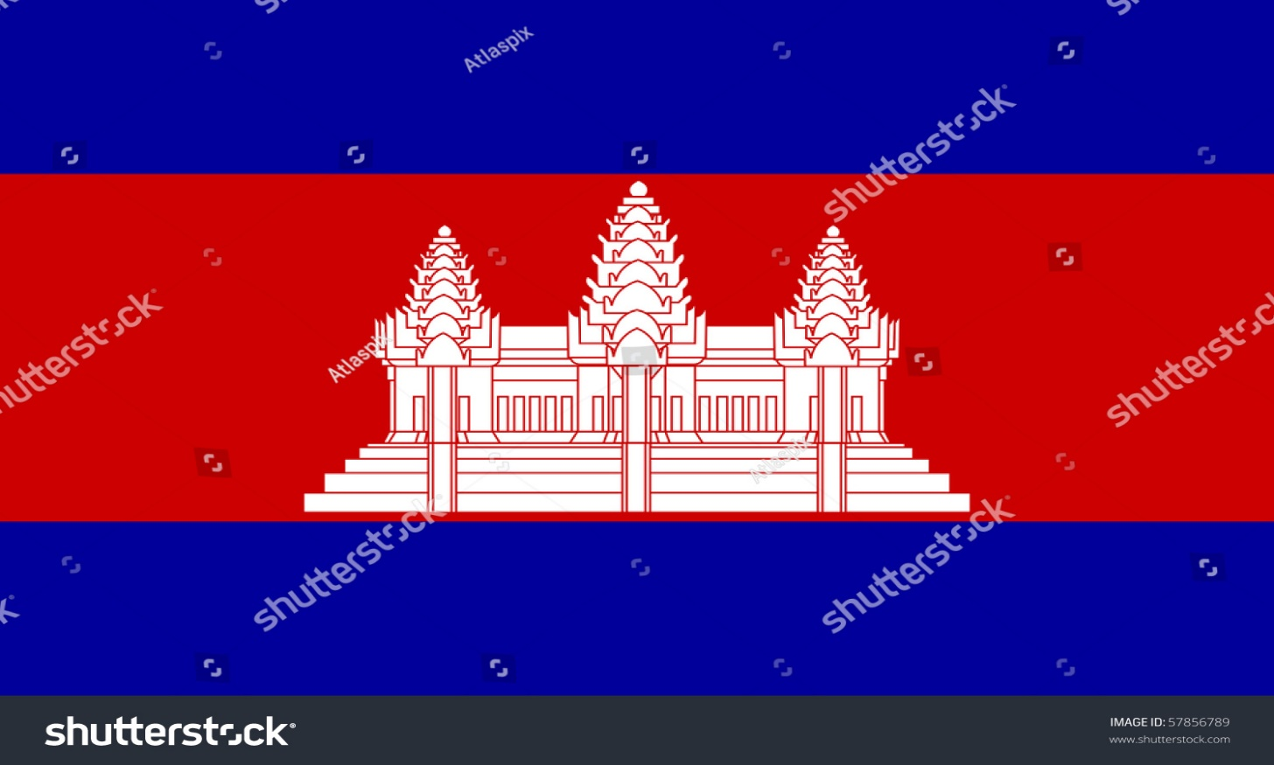
Cambodia’s SOVEREIGNTY- អធិបតេយ្យភាពខ្មែរ
How does a state become sovereign?
Although it's not clearly laid out in law, a territory essentially becomes a sovereign state when its independence is recognized by the United Nations.
Cambodia became a Member State of the United Nations in 1955.
Prior to that in 1951, Cambodia became a member of UNESCO and immediately established its own National Commission.
Picture of the flag:
Indicates the Sovereign state flag of country of Cambodia in official colors
Picture of Map with National Boundary Line:
Indicates Cambodia is a sovereign State within its territory.
Notes:
Sources: (1) https://unsdg.un.org/un-in-action/Cambodia (2) https://www.nationsonline.org/oneworld/map/cambodia-political-map.htm
(3) https://www.shutterstock.com/image-illustration/sovereign-state-flag-country-cambodia-official-57856789

Slide 5



Loss of SOVEREIGNTY- ការបាត់បង់អធិបតេយ្យភាព
How can a State lose its sovereignty?
1. The main way nations lose their sovereignty is by being conquered. They can also lose some of it by merger.
(ex. when Tanganyika and Zanzibar merged to become Tanzania is the example.)
2. The most obvious way that a country lose its sovereignty: if a country is invaded and occupied by another country, then the invaded country loses its power to self-government. A puppet government may be established, under the “supervision” of the invaders.
(ex. when Vietnam invaded and occupied Cambodia in 1978 and then established a puppet government under its supervision is an example.)
3. A nation can lose its sovereignty if it allows foreigners access to certain functions with the government.
(ex. Between 1800s to 1900s, Westerners came to Asia and introduced their ways of running the country as “superior” ways. They made offers to local rulers, they could improve the country if they were allowed to act as officials of the government. Result, almost every nation in Asia had lost their sovereignty to the foreigners who nudged themselves between the rulers and their people, isolating the rulers and then force them to sign the country away to the “protection” of the Empire is an example.)
We have lost our sovereignty, or we have lost our economic sovereignty, as though the sovereignty of a state also operated in ways independent of the economic sphere.
Notes on the ‘Loss of Sovereignty’
by Richard McAleavey | 20 Apr 2012
Notes:
Source: https://criticallegalthinking.com/2012/04/20/notes-on-the-loss-of-sovereignty/
https://www.quora.com

Slide 6
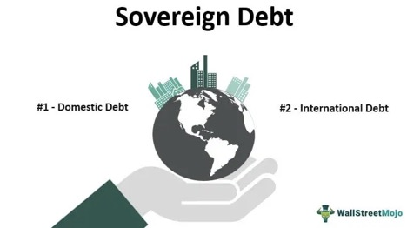
SOVEREIGN debt- បំណុលអធិបតេយ្យ
Modern day, what happened when State defaults on its Sovereign Debt?
Most defaults are followed by a settlement between creditors and the debtor government.
The settlement may take the form of a debt exchange or debt restructuring.
2. Debt Diplomacy to Expand the Influence
also known as Debt Trap Diplomacy:
(Lauren Frayer, NPR News, Dec. 13, 2019)
Ex. China is apprehensive about its investments in poor countries being characterized as a debt trap.
Analysts point to two examples of the debt trap: (VOA Khmer, (Apr. 12, 2021)
China’s takeover of Hambantota Port in Sri Lanka,
China’s takeover of the State-run
Electricity of Laos.
Sovereign Debt Definition
Sovereign debt refers to the amount of money borrowed by a country’s central government. It is primarily achieved by selling government bonds and securities.
Explanation
Whenever a country needs money to finance its growth initiatives, it can do so by two modes:
By raising taxes,
By issuing government bonds
Sovereign debt is issued in two ways:
raised domestically, and
borrowing from international organizations ( like World Bank).
Domestic Debt:
Governments issue bonds which are bought by domestic lenders
International Debt:
International lenders lend to the country that cannot raise money domestically.
Notes:
Sources: Dheeraj Vaidya, CFA, FRM, https://www.wallstreetmojo.com/sovereign-debt/ https://en.wikipedia.org/wiki/Sovereign_default
Juan Carlos Hatchondo, Economic Quarterly Volume 93, Number 2, Spring 2007, Pages 163-187 https://core.ac.uk/download/pdf/6993505.pdf

Slide 7
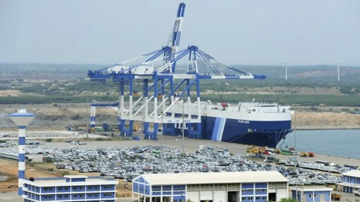
SOVEREIGN DEBTs of Sri Lanka & laos
បំណុលអធិបតេយ្យ នៃស្រីឡាំងកា និង លាវ
In Dec. 2017, Sri Lanka handed over its commercial port of Hambantota to Chinese State firm on a 99-year concession deal after struggling to repay its sovereign debts of more than $5 billion to China’s state-owned enterprise, https://www.voacambodia.com,(Apr.12,2021)
China signs 99-year lease on Sri Lanka’s Hambantota port Critics denounce move as an erosion of country’s sovereignty. For Beijing the Hambantota port project is apart of One Belt One Road' initiative. Kiran Stacey, Financial Times, in New Delhi (Dec. 11, 2017)
China has absolute control of the Colombo Port City, 700 km from Chennai, and a 99-year lease of the Hambantota Port as well as 15,000 acres of land around it.​ (Dragon’s New Lair,(How China’s Expansionism is Taking Root in Sri Lanka (Jun. 3, 2021)
China’s Rising Influence in Laos
Laos, facing a pandemic-triggered economic crisis and credit default in 2020, gave up a majority share of its state-run energy firm, Laos’s Electricity to China’s state-owned China Southern Power Grid. https://www.voacambodia.com,(Apr. 12,2021)
The pandemic has torpedoed Laos’ tourism industry, pushing the communist-led nation to the brink of sovereign default.
As of June 2020, the country’s reserves had dwindled to $864 million, insufficient to meet the national debt obligation totaling more than $1 billion annually until the end of 2024. https://thediplomat.com(Sept. 2020)
Notes:
Source: https://www.voacambodia.com,(Apr. 12, 2021) Kiran Stacey, Financial Times, in New Delhi, (Dec. 11, 2017)
Drago’s New Lair: How China’s Expansionism is Taking Root in Sri Lanka, https://www.news 18.com,(Jun. 3, 2021)

Slide 8
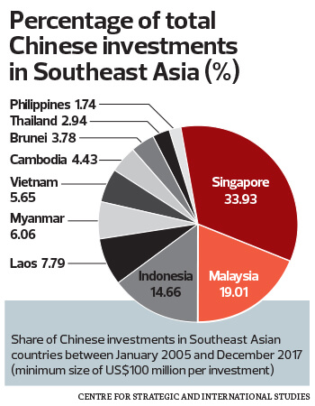
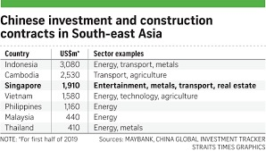
China’s influence in southeast asia-
ឥទ្ធិពលចិន នៅក្នុងតំបន់អាស៊ីអាគ្នេ
China in Southeast Asia: Competition on the verge of a Conflict
Southeast Asia is a region that differs from other places in the world where China pursues its expansion policy in struggling for resources and influence. https://lansinginstitute.org (Sept. 14, 2020)
Notes:
Source: China in Southeast Asia: Competition on the Verge of a Conflict, (Sept. 14, 2020) https://lansinginstitute.org/2020/09/14/china-in-southeast-asia-competition-on-the-verge-of-a-conflict/

Slide 9
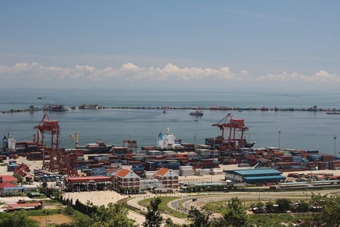
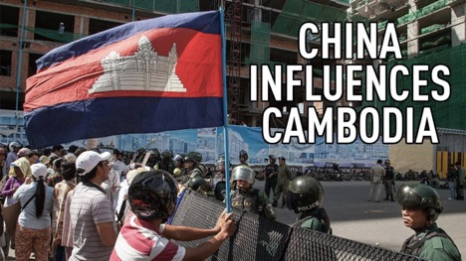
Cambodia’s SOVEREIGN debt- បំណុលអធិបតេយ្យខ្មែរ
How does China Influence Cambodia?
China has financed around 70 per cent of Cambodia’s much-needed and infrastructures and by 2017, Cambodia had received $4.2 billion in Chinese Grants and Loans. https://www.eastasiaforum.org,(Dec. 26, 2020)
Cambodia’s foreign debt stood at $8.8 billion by the end of 2020 with $3.9 billion, or 44 percent of the total debt is owed to China. (Cambodia’s Finance Ministry Records)(Apr. 12, 2021)
Dara Sakor, a $3.8 billion China-backed investment zone encompassing 20% of Cambodia’s coastline, is unlike any other in the developing Southeast Asian national. Controlled by Chinese company with a 99-year lease, it features phased plans for an international airport, a deep-water seaport and industrial park along with a luxury resort complete with power stations, water treatment plants and medical facilities. https://www.bloombergquint.com/business/u-s-fears-cambodia-resort-may-become-china-naval-base,(Jul 19, 2019)
China is Cambodia’s largest source of infrastructure investment and has become the country’s chief patron on the economic and political front. https://www.voacambodia.com,(Apr.12, 2021)
Chinese direct investment in Cambodia reached $860 million in the first 11 months of 2020, up 70 per cent from the same period in 2019. https://www.phnompenhpost.com,(Jan. 1,2021)
According to associate professor Sophal Ear, “China was apprehensive about their investments in Cambodia being characterized as a debt trap.” https://www.voacambodia.com (Apr. 12, 2021)
Notes:
Source: https://www.eastasiaforum.org (Dec. 26, 2020) Cambodia’s Finance Ministry Records, (Apr. 12, 2021)
https://www.voacambodia.com (Apr. 12, 2021) https://www.phnompenhpost.com (Jan. 1, 2021)

Slide 10
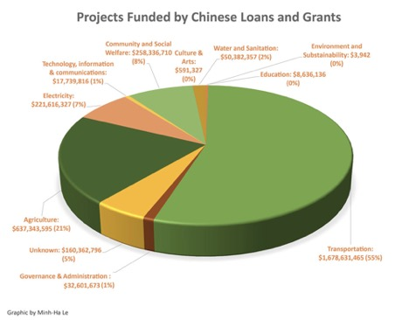
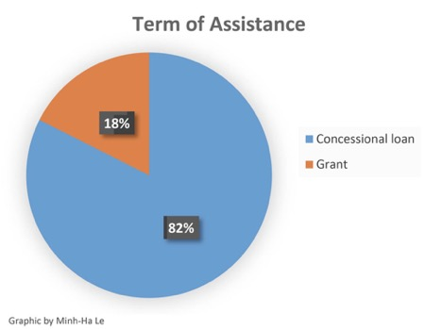
Cambodia’s SOVEREIGN debt- បំណុលអធិបតេយ្យខ្មែរ
Transparency of Chinese Loans:
China is Cambodia’s largest foreign donor, but many aid agreements between the two nations lack transparency, raising questions about whether Beijing is trying to buy influence in the country and how the money is being spent. https://www.rfa.org/English/news/special/chinacambodia/loans.html
A Chinese company is expected to begin construction on 2nd phase of Sports Complex on 85 hectares (210 acres) of land in Russei Keo district 2017 using the $150 million financed by China.
https://www.rfa.org/English/news/special/chinacambodia/loans.html
The $1.9 billion road projects in capital invested by China Road and Bridge Corp (CRBC) scheduled to be completed in early 2023. https://www.phnompenhpost.com (Jan. 5,2021)
Bilateral trade between Cambodia and China was worth $9.42 billion in 2019, up 27.29 per cent from $7.4 billion in 2018, according to the Chinese Embassy in Phnom Penh. https://www.phnompenhpost.com(Jan. 5, 2021)
China and Cambodia reached an agreement to allow Beijing to make use of Cambodia’s navy base near Sihanoukville. https://www.wsj.com/articles/secret-deal-for-chinese-naval-outpost-in-cambodia-raises-u-s-fears-of-beijings-ambitions-11563732482g,(Jul. 22, 2019)
According to Em Sovannara, a political commentator, “82% of financial assistance from China comes in form of Concessional loan and only 18% is in form of Grant, but in case Cambodia fails to make a repayment, it could end up like Laos and Sri Lanka.” https://www.voacambodia.com(Apr.12,2021); https://rfa/English/news/special/chinacambodia/loans.html
Notes:
Source: Cheng Meng Chou for RFA Khmer Services, https://www.rfa.org/English/news/special/chinacambodia/loans.html
China FDI hits $860M in first 11 months of 2020, https://www.phnompenhpost.com (Jan.5,2021); https://www.voacambodia.com,(Apr. 12, 2021)

