Slide 1
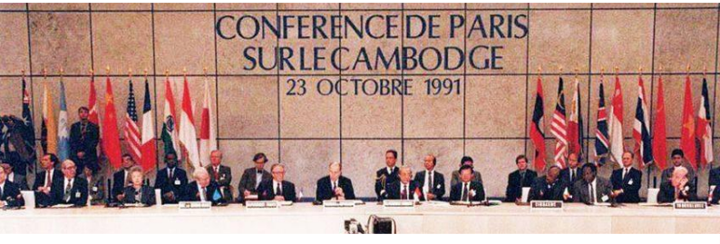
The 30th Anniversary of Cambodia’s Paris Peace Agreements
1991 Paris Peace Agreements on Cambodia
Promises
Human Rights
Democracy
Territorial integrity
Sovereignty
Reconstruction of Cambodia
__________________
Fundamental Freedoms
Peace
Khmernetwork.org

Slide 2
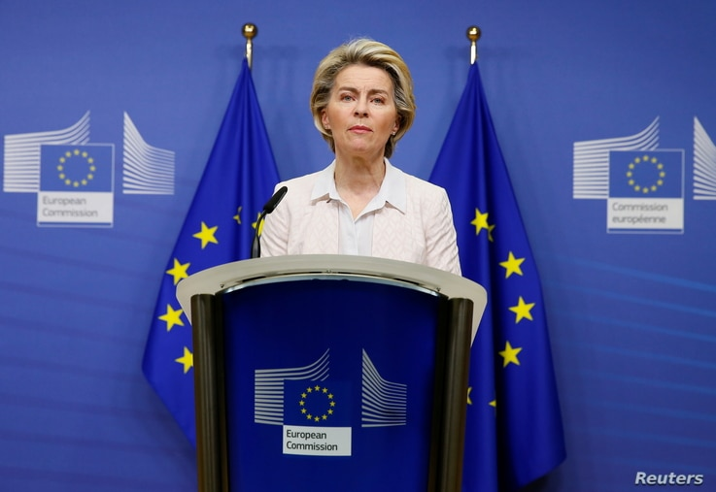
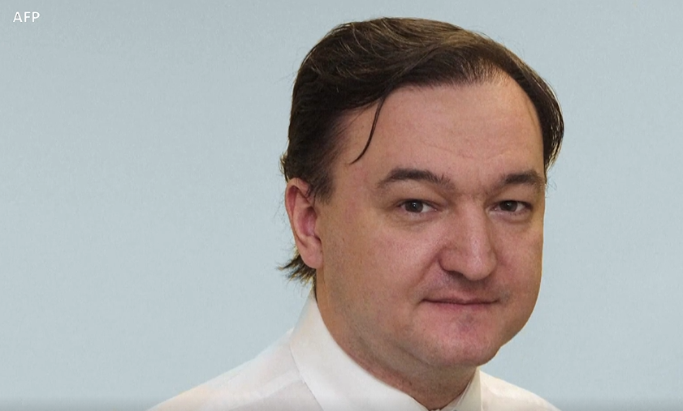
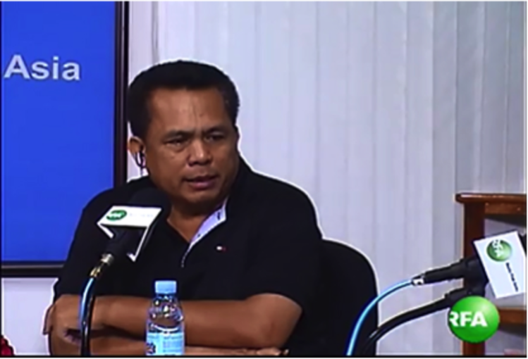
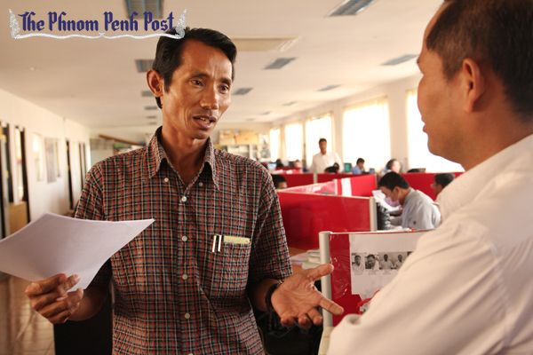
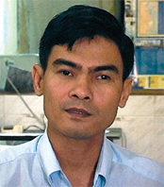
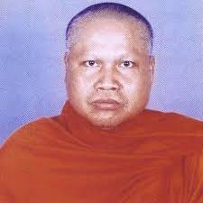
30th Anniversary of Cambodia’s 1991 Paris Peace Agreements October 23, 2021
UN – Human Rights | Global Magnitsky Laws
The European Union officially adopts the legislation on December 10.2020— World Human Rights
The European Union (EU) is a group of 28 nations in Europe, formed in the aftermath of World War II.
Europe Targets Human Rights Abusers With ‘Magnitsky Laws”
LONDON - Human rights abusers will face asset freezes and travel bans under new legislation adopted by the European Union.
The so-called Magnitsky laws, officially titled the EU Human Rights Global Sanctions Regime, would target those accused of crimes including genocide, torture, assassination and arbitrary detentions
Kem Ley was a Cambodian activist, physician, and political commentator.
On 7 July, Global Witness released a report titled 'Hostile Takeover'.
Kem Ley discussed this report just two days before his death…
He was assassinated at a petrol station in Central Phnom Penh on 10 July 2016
Chut Wutty was one of Cambodia’s most vocal environmental activists.
He was killed on 26th April 2012.
Chea Vichea was the leader of the Free Trade Union of Workers of Kingdom of Cambodia .
He was Assassinated on Chinese New Year 1- 22-2004
Buddhist Monk Sam Bunthoeun
President, Buddhist Meditation Center
“Voting was not against Buddhist Principles”
He was Assassinated on 2.6.2003
Khmernetwork.org

